Slide 1

Guilford Community Care Network (GCCN) program Overview
2021

Slide 2
Vision & Mission Statements
Vision: Access to quality healthcare for all
Mission: To ensure that all persons have access to quality, comprehensive and affordable healthcare through innovative community partnerships

Slide 3
GCCN is a safety net program. What is a safety net?
The Institute of Medicine defines the safety net as: “Those providers that organize and deliver a significant level of health care and other related services to uninsured, Medicaid, and other vulnerable patients.” 30 Core Safety Net providers rely heavily on federal, state, and local grants and other subsidies to provide care for the indigent. Guilford County’s safety net (Guilford Community Care Network) is comprised of an array of provider organizations.

Slide 4
Who do we serve?
The Guilford Community Care Network Serves:
Any patient with an income between 0%-200% of the Federal Poverty Level.
The Network is positively impacting folks experiencing poverty and the social determinants of health by increasing access to care and services

Slide 5


Key programs
The Guilford Dental Access Program (GDAP)-Dental Clinic
The Guilford Community Care Network (GCCN)-Safety Net/Coordinated Care

Slide 6

Guilford Dental Access Program
The mission of the program is to restore dental health for low-income Uninsured residents of Guilford County
Established in 2005 to provide preventative and restorative dental care to needed patients
All patients seen at our Dental clinic must have a GCCN Orange Card and be referred from their Primary Care Provider to be seen
A $40 cash co-pay is due at each visit (effective 10/1/21)
Scholarships are available for our unsheltered patients (as funding permits)

Slide 7
GCCN: What is Coordinated Care?
We have 3 main components of Coordinated Care:
Eligibility & Enrollment-looking at a patient’s income and assets to determine if they are eligible for our program and assigning them to a Primary Care Medical Provider
Provider Outreach/Specialty Care Access including Dental-identifying Specialists in the community that are donating their time and services to see our GCCN patients and working to schedule patient appointments for those services
Care Management focusing on the Social Determinants of Health-assisting clients with social and medical resources in the community

Slide 8
GCCN Criteria
You must be a resident of Guilford County (Proof of minimum of 3 months residency)
You cannot be eligible for state or federal sponsored healthcare insurance, including ACA Federally Facilitated Marketplace, Veterans Administration, Medicaid, or Medicare. (Exemption Required)
An annual income between 0-200% FPL
Valid Photo ID such as driver’s license, state identification card, passport, or identification from home country.
Proof of Income/Assets
You are first required to see if you are eligible to enroll in the ACA Health Insurance Marketplace before enrolling into the GCCN if over 100% FPL (exemption required) www.healthcare.gov; 1-800-318-2596; and 1-855-733-3711

Slide 9
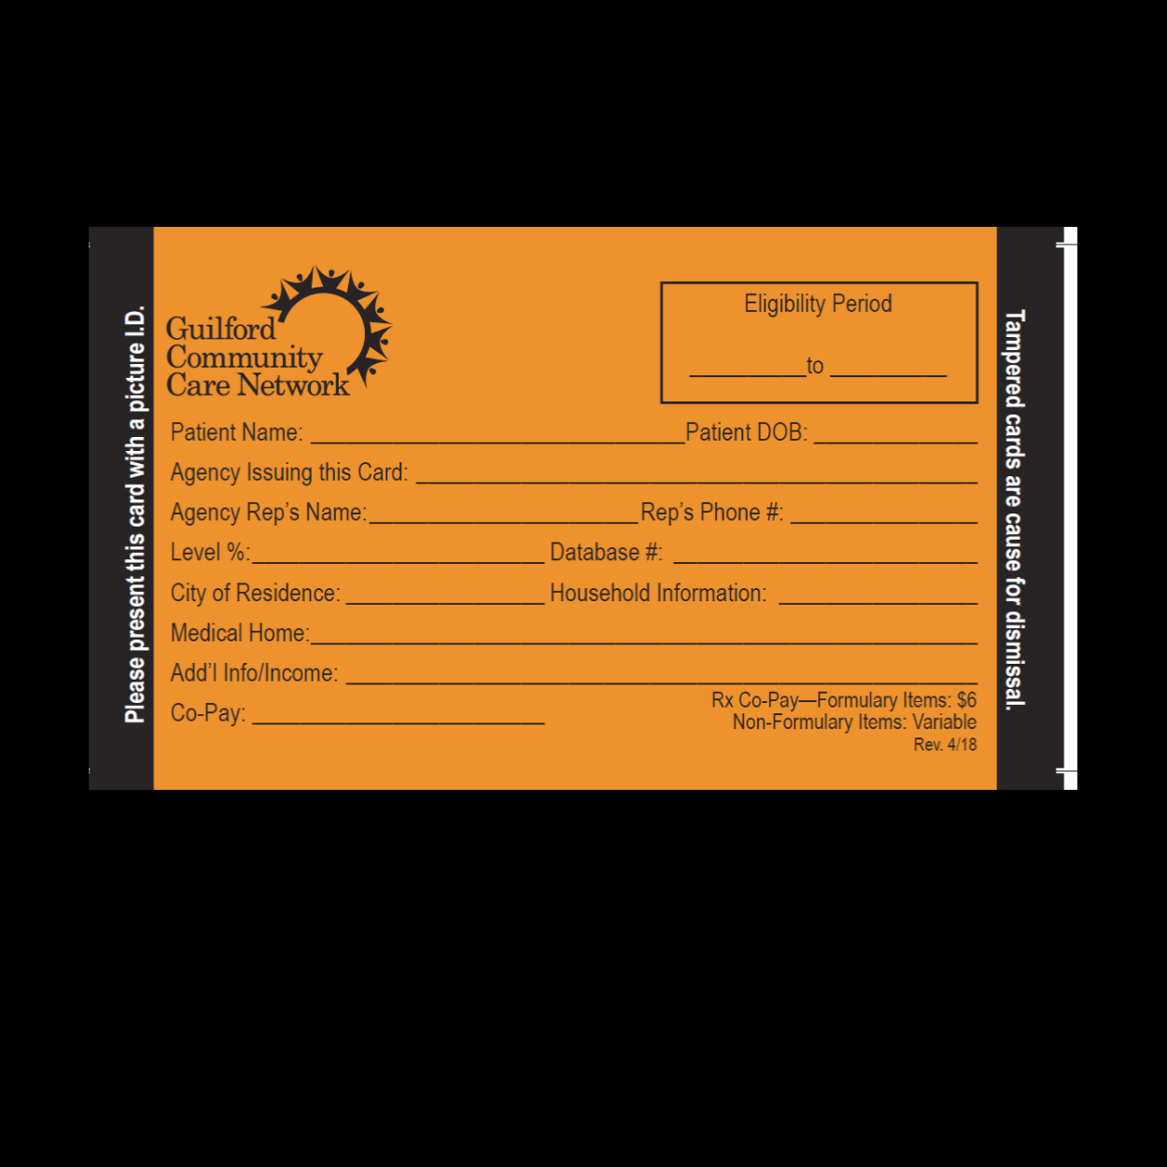
What is an Orange Card?

Slide 10
2021 Federal Poverty Guidelines

Slide 11
HOW TO APPLY to Our Program (Eligibility & Enrollment)
Visit one of our partner sites in the community and enroll with an Eligibility & Enrollment Specialist (located at Cone Community Health & Wellness-enrollment for CHW, Elmsley, PCC and Renaissance, and Cone Internal Medicine currently)
Drop off completed applications and supporting documents at DSS Greensboro (1203 Maple St) on Monday, Tuesday or Thursday from 9am-1pm
Enroll Virtually
  To apply virtually you can do one of the following:
  • Email the application and copies of all supporting documents to oc@guilfordccn.org.
  • Fax the application and copies of all supporting documents to 1.800.325.1945.
  • Mail application and copies of all supporting documents to the GCCN Administrative office at PO BOX 4031 Greensboro, NC 27404.

Slide 12
Provider outreach & Specialty Care Access
The Provider Outreach Program works to create access to Primary and Specialty Care Providers in the community for our GCCN patients.
The Goal is to improve health outcomes by coordinating referrals from the Primary Care Provider to the Specialty Care Provider and assisting the patient with all needed information to get the care they need.
We have traditionally averaged around 100 Specialty Care Referrals per month (not including Dental-pre COVID).

Slide 13

Care Management Program
Assist patients with navigating the Health Care System
Engage patients and assist with Care Coordination within GCCN
Treat all patients with dignity and respect
Empower patients to take ownership of their health and to utilize resources that are available
Provide patients with access to needed resources (based on the Social Determinants of Health (SDOH) screener)
  SDOH includes (Transportation, Housing, Interpersonal Safety, Food Security, and Employment

Slide 14
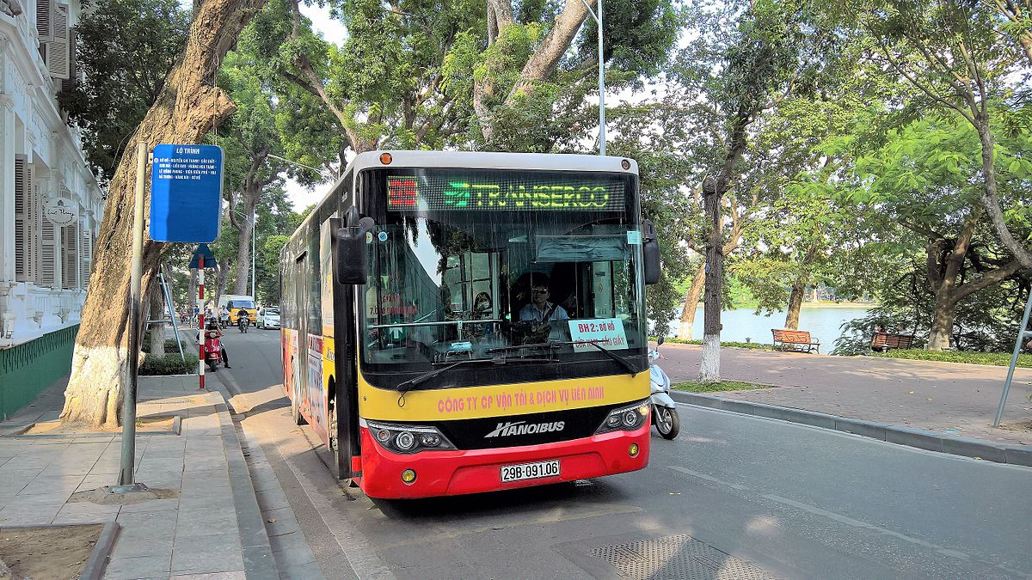

Addressing the Social Determinants of Health (SDOH)
We have partnered with the Guilford County Transportation and Mobility to provide transportation to Medical and Pharmacy appointments for GCCN patients
In addition, The Greensboro Transit Authority has an agreement for GCCN patients to get reduced fare on all bus rides by showing their Orange Card
All active GCCN patients can go on Saturday’s to the Greensboro Farmer’s Market and the High Point Farmer’s Market to receive $10 in fresh food each week

Slide 15
What is our Goal?
Serve as an integrated care hub and provide access to care for all uninsured, low income residents of Guilford County (those experiencing poverty)
Address the Social Determinants of Health (non medical drives of health care)
Improve Guilford County Health Status and work to eliminate health disparities
Coordination of Care/Services (assist with transportation to Medical & Pharmacy appointments, partner with Greensboro and High Point Farmer’s Markets for fresh food access, deliver food boxes to limited mobility patients, provide educational materials on managing health conditions, etc.)
Reduce ED/Hospital Utilization
Reduce the cost of care
Advocate
As it relates to ACA, we have a goal of working to close the health insurance gap

Slide 16


GCCN Contact Info
GCCN mailing address is PO BOX 4031 Greensboro, NC 27404
Our Administrative office phone number is 336.895.4900
www.guilfordccn.org
oc@guilfordccn.org

